Slide 1
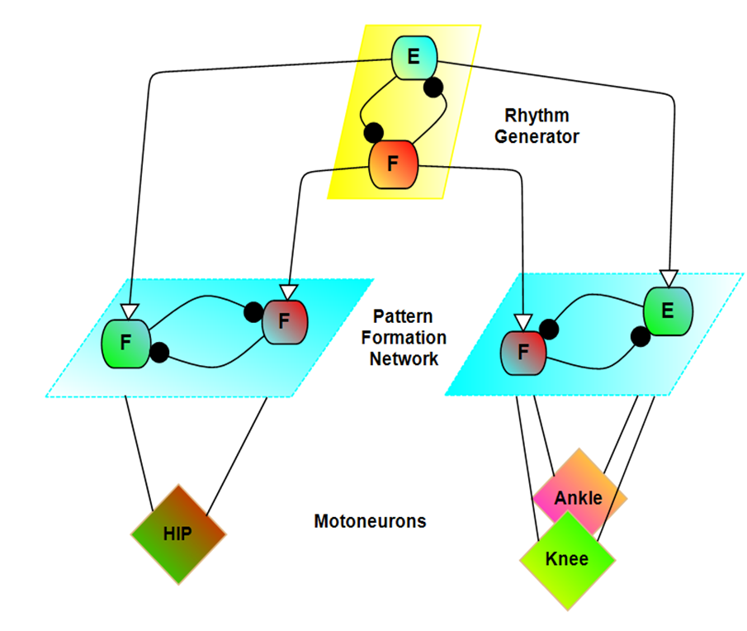
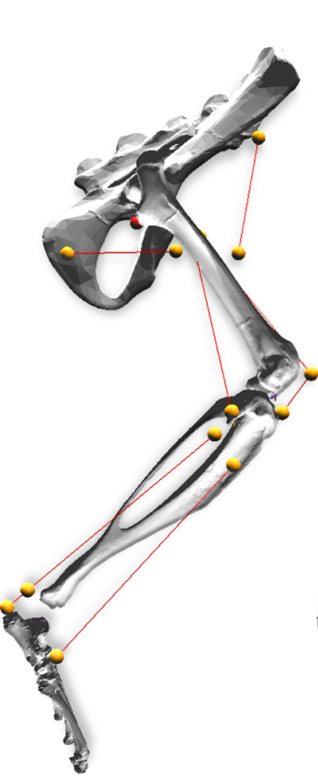
Overview of previous model
Monoarticular antagonist muscles
Individual joint control
Two-layer CPGs
Replicate Walking
Reproduced non-resetting deletions
Kinematics do not match well,
especially at the ankle

Slide 2
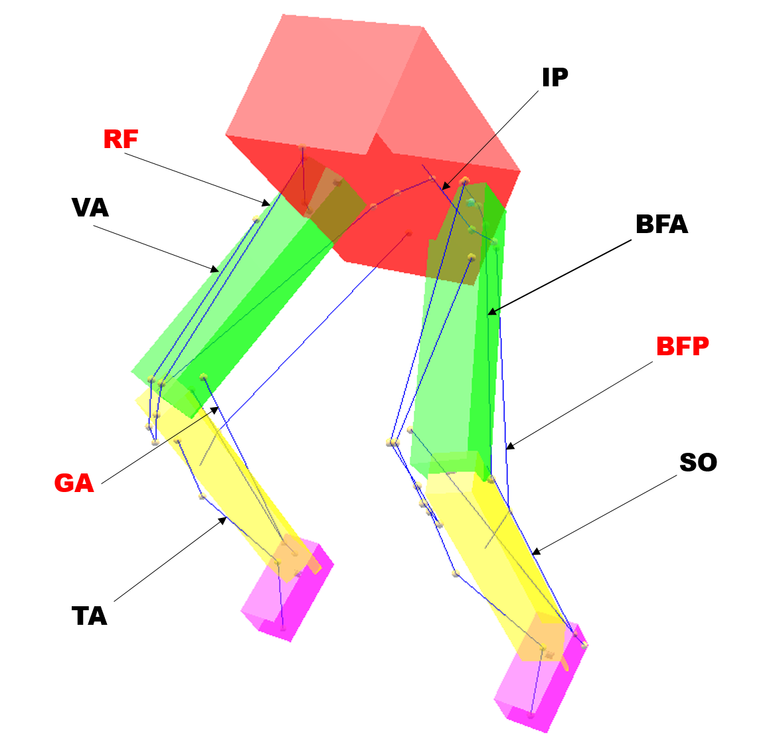
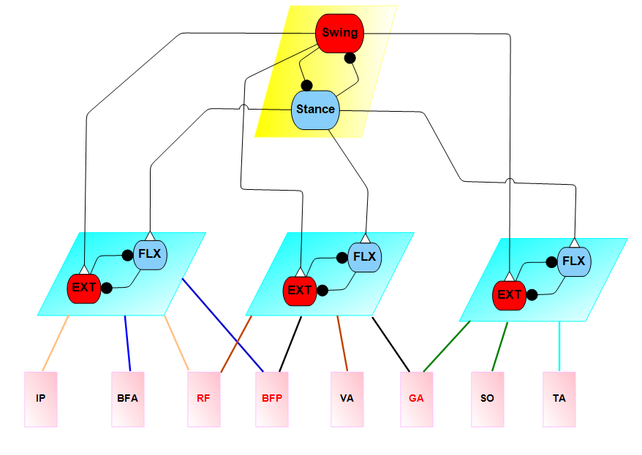
Biarticular muscle model
The biarticular muscle model includes 8 muscles, 3 of which are biarticular (red).
IP
BFA
BFP
RF
VA
TA
GA
SO
Iliopsoas
Anterior biceps
Posterior biceps
Rectus femoris
Vastii
Tibialis anterior
Gastrocnemii
Soleus
Notes:
Orange connections represent hip flexion; blue connections represent hip extension; brown connections represent knee extension; black connections represent knee flexion; green connections represent ankle extension; and the cyan connection represents ankle flexion.

Slide 3
Inverse Kinematics of Biarticular muscle
Joint motion data is used to simulate the desired walking profile of the rat. The muscle profile of the leg during walking could then be used to calculate the desired MN activations for the biarticular muscle model.

Slide 4
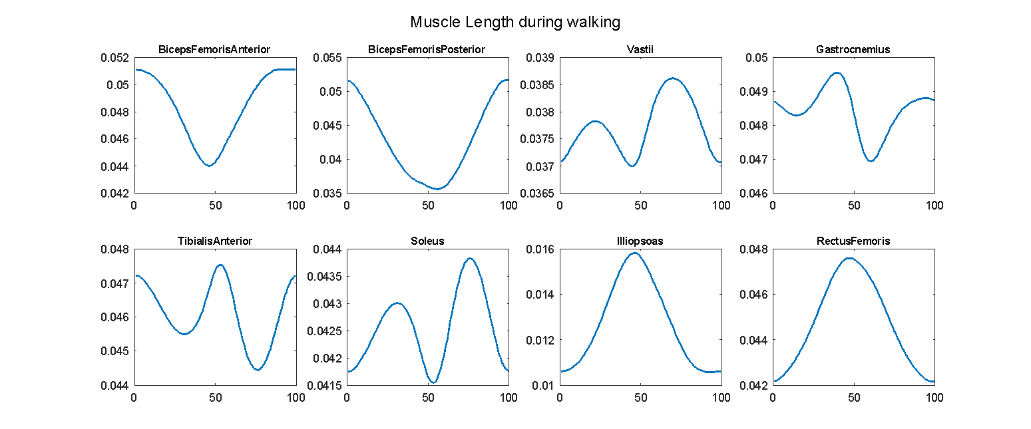
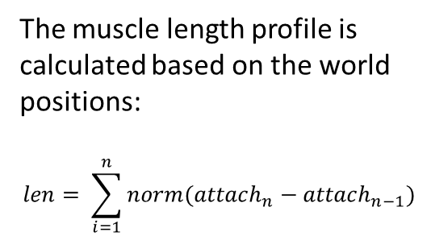
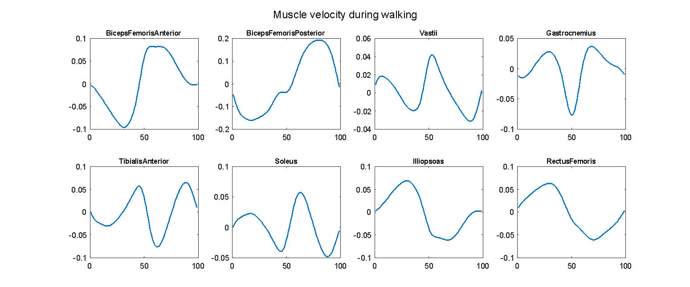
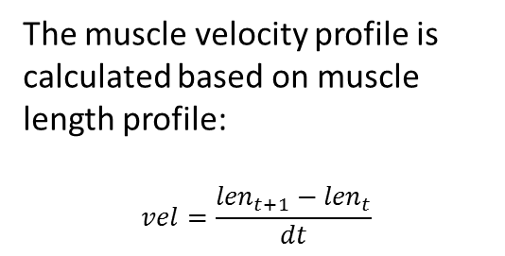
Muscle motion Profile

Slide 5
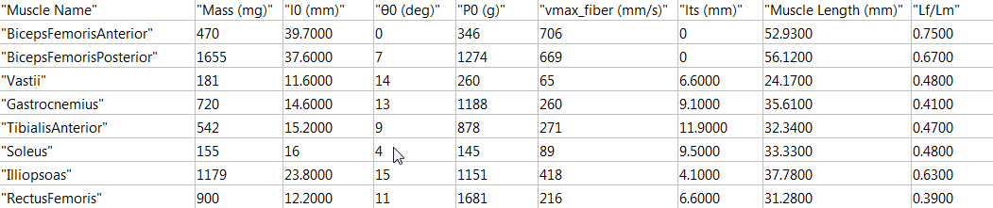
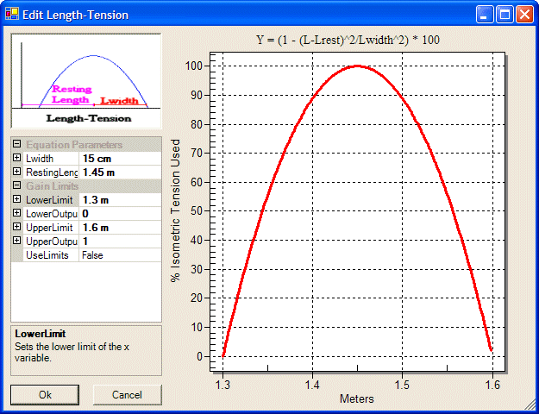
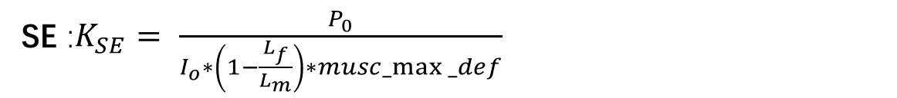

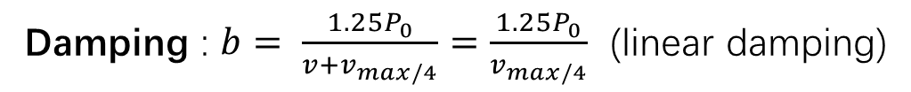
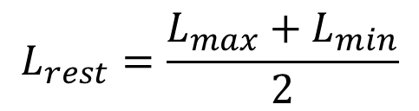

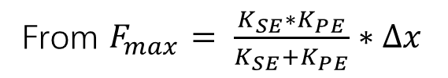
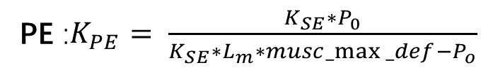
Muscle parameters
$$L_{rest}=\frac{L_{max}+L_{min}}{2}$$
$$L_{width}=L_{max}−L_{min}$$
Damping : $b= \frac{{1.25P}_{0}}{{v+v}_{max/4}}=\frac{{1.25P}_{0}}{v_{max/4}}$ (linear damping)
$T\left(l\right)∈ \left[0.75, 1\right]$ Passive force included
From Hill’s 1938 & Freivalds 2011
$musc_max⁡_def=0.04$ (Winter(1990) and Meijer (1998)
SE :$K_{SE}= \frac{P_{0}}{I_{o}∗\left(1−\frac{L_{f}}{L_{m}}\right)∗musc_max⁡_def}$
From ‘quick release’ method, apply a force as Po, the defection will be the shortening length of tendon. (Winter 1990, Wilkie 1956)
PE :$K_{PE}= \frac{{K_{SE}∗P}_{0}}{{K_{SE}∗L}_{m}∗musc_max⁡_def−P_{o}}$
From $F_{max}= \frac{K_{SE}∗K_{PE}}{K_{SE}+K_{PE}}∗∆x$

Slide 6
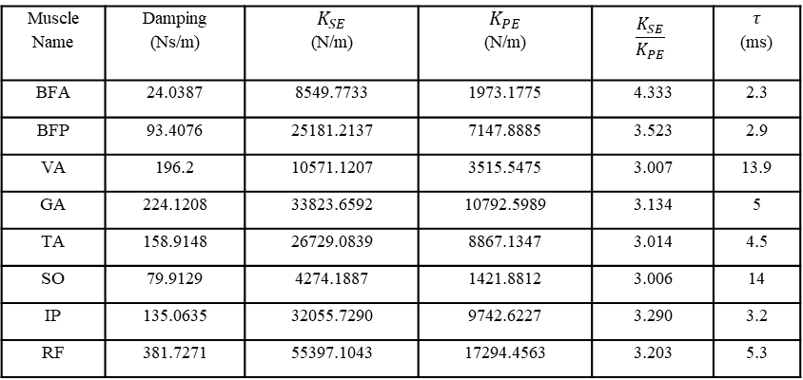
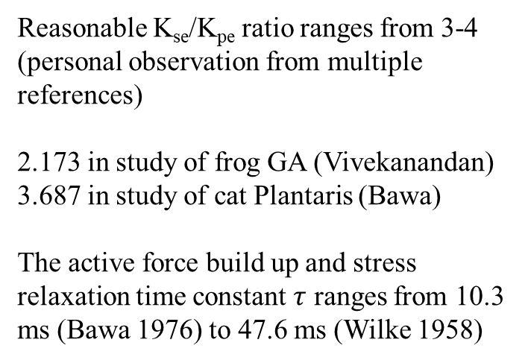
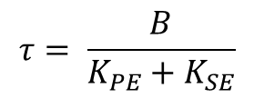
Muscle Passive Tension
Muscle Name | Damping (Ns/m) | $$K_{SE}$$ (N/m) | $$K_{PE}$$ (N/m) | $$\frac{K_{SE}}{K_{PE}}$$ | $$τ$$ (ms)
BFA | 24.0387 | 8549.7733 | 1973.1775 | 4.333 | 2.3
BFP | 93.4076 | 25181.2137 | 7147.8885 | 3.523 | 2.9
VA | 196.2 | 10571.1207 | 3515.5475 | 3.007 | 13.9
GA | 224.1208 | 33823.6592 | 10792.5989 | 3.134 | 5
TA | 158.9148 | 26729.0839 | 8867.1347 | 3.014 | 4.5
SO | 79.9129 | 4274.1887 | 1421.8812 | 3.006 | 14
IP | 135.0635 | 32055.7290 | 9742.6227 | 3.290 | 3.2
RF | 381.7271 | 55397.1043 | 17294.4563 | 3.203 | 5.3
$$τ= \frac{B}{K_{PE}+K_{SE}}$$
Reasonable K_{se}/K_{pe} ratio ranges from 3-4 (personal observation from multiple references)
2.173 in study of frog GA (Vivekanandan)
3.687 in study of cat Plantaris (Bawa)
The active force build up and stress relaxation time constant $τ$ ranges from 10.3 ms (Bawa 1976) to 47.6 ms (Wilke 1958)

Slide 7
Cartoon of different phases during rat walking
Passive muscle tension is closely related to joint motion
Tension in hip muscles is reciprocal during toe off and mid-swing phases as compared to the mid stance and touch down phases.
Tension in the ankle and knee joint muscles are mirrored between the stance and swing phases.
Experimental passive tension data could be used to compare with our calculated tension profiles and to validate our approach to developing the muscle parameters

Slide 8
Joint Torques
Emanuel’s Torques
Alex’s Torques
Lagrange Torques
Our German collaborator Emanuel Andrada has provides us with stance torque, which Alex Hunt then used to develop swing torque profiles in Simulink. It was necessary to smooth the data heavily, leading us to explore the possibility of developing Lagrangian equations of motion to calculate the swing torque.

Slide 9
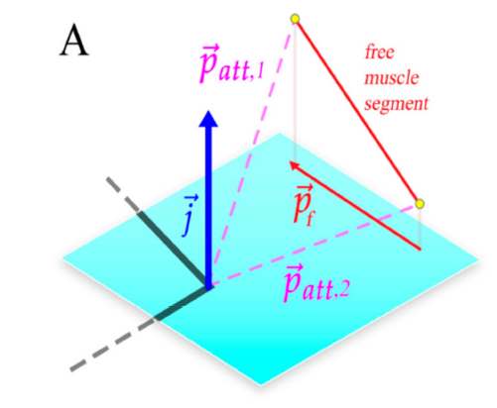
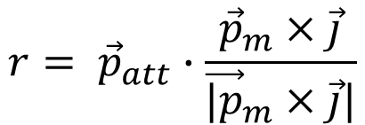
Muscle moment arms
To calculate the muscle force for desired joint torque, muscle moment arms are calculated at each timestep
during walking.
This process, developed by Fletcher, has been modified in two ways to aid in my work:
Muscle moment arms are only calculated for muscle segments that span a joint
Rather than first projecting muscle segments onto a plane defined by the joint axis, moment arms are simply calculated as a direct line between the muscle segment and joint rotation axis
$$r= {\vec{p}}_{att}∙\frac{{\vec{p}}_{m}×\vec{j}}{{\vec{|p}}_{m}×\vec{j}|}$$
(Young et.al 2019)

Slide 10
Muscle moment profiles for extensors are almost directly proportional to the joint angle while flexion muscle moment arm profiles are the inverse of joint angles
The BFP has large moment arms for both the hip and knee joint when compared to other muscles due to its biomechanical configuration.
The GA and SO moment arms are similar for the ankle joint and have an inverse profile of the TA

Slide 11
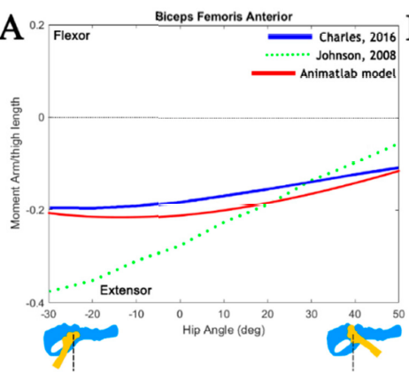
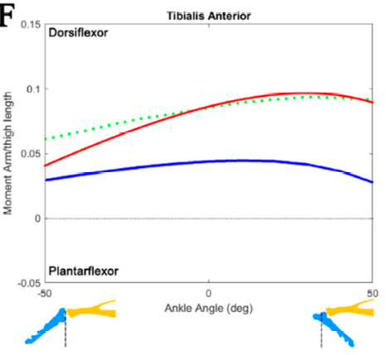
When compared with the work in Fletcher’s muscle moment arm publication, the BFA profile matches well.
The TA moment arm profile has a similar shape but is a bit shifted up.

Slide 12
Muscle Tension
After developing detailed muscle moment arm profiles and incorporating desired muscle torques, it is possible to solve for necessary muscle tension.
IP
BFA
BFP
RF
VA
TA
GA
SO
T7
T1
T2
T8
T3
T5
T4
T6
Unknowns: Tension [T1 T2 T3 T4 T5 T6 T7 T8]
Equations:
$${Eq1: T}_{1}∗r_{1}+T_{2}∗r_{2}+T_{7}∗r_{7}+T_{8}∗r_{8}−{Torque}_{Hip}=0$$
$${Eq2: T}_{3}∗r_{3}+T_{8}∗r_{8}′+T_{2}∗r_{2}′+T_{4}∗r_{4}−{Torque}_{Knee}=0$$
$${Eq3: T}_{4}∗r_{4}′+T_{6}∗r_{6}+T_{5}∗r_{5}−{Torque}_{Ankle}=0$$
I tried use fsolve to calculate the muscle force, but was unable to converge to a steady solution.
The bisection method I originally implemented did not work either. So, I used a gradient descent method to search for solutions.
$$Objective=1e6∗\left(Eq1^{2}+Eq2^{2}+Eq3^{2}\right)+1e3∗constraints$$
(Daniel 2012)

Slide 13
For example, if the cost function is simply the sum of all muscle forces, the result looks like:
IP
BFA
BFP
RF
VA
TA
GA
SO
T7
T1
T2
T8
T3
T5
T4
T6

Slide 14
Current goals:
Find a more effective cost function for distributing forces to the muscles
Develop a method to convert the resulting muscle tension profiles into MN activation profiles. This would allow us to compare results with experimentally derived EMG data.

